Slide 1
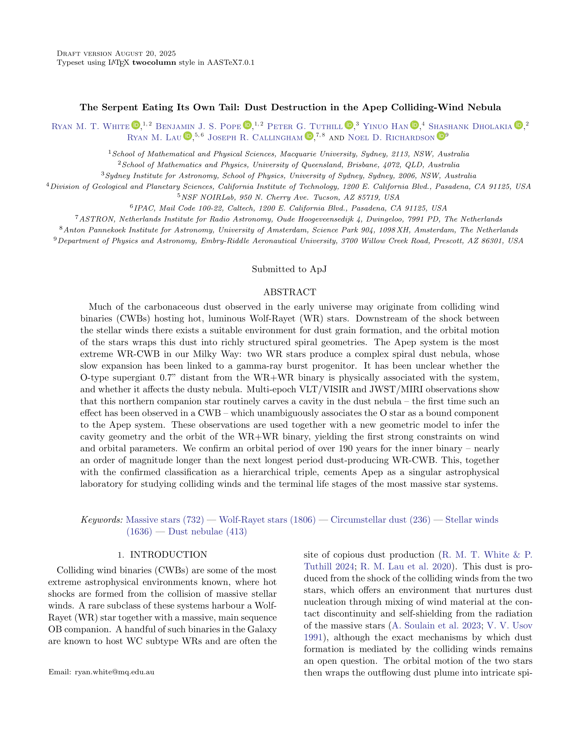

































































































































































































































































































































































There are mysterious spiral nebulae around some massive stars... Read all about it in my new paper titled:
Give it to me straight, doc:
Lots of massive stars, those much heavier than our Sun, come in pairs. These stars have ‘winds’, and since they are so close, their two winds smash together! This makes a hell of a lot of carbon soot which we can then image with our fancy telescopes. We use the (very fancy) James Webb Space Telescope to look at one such system - the Apep System, named after the Egyptian god of chaos - and we use this soot to figure out (almost) everything that’s going on. Turns out that there’s not just two, but three stars and it’s all very complicated!

Slide 2
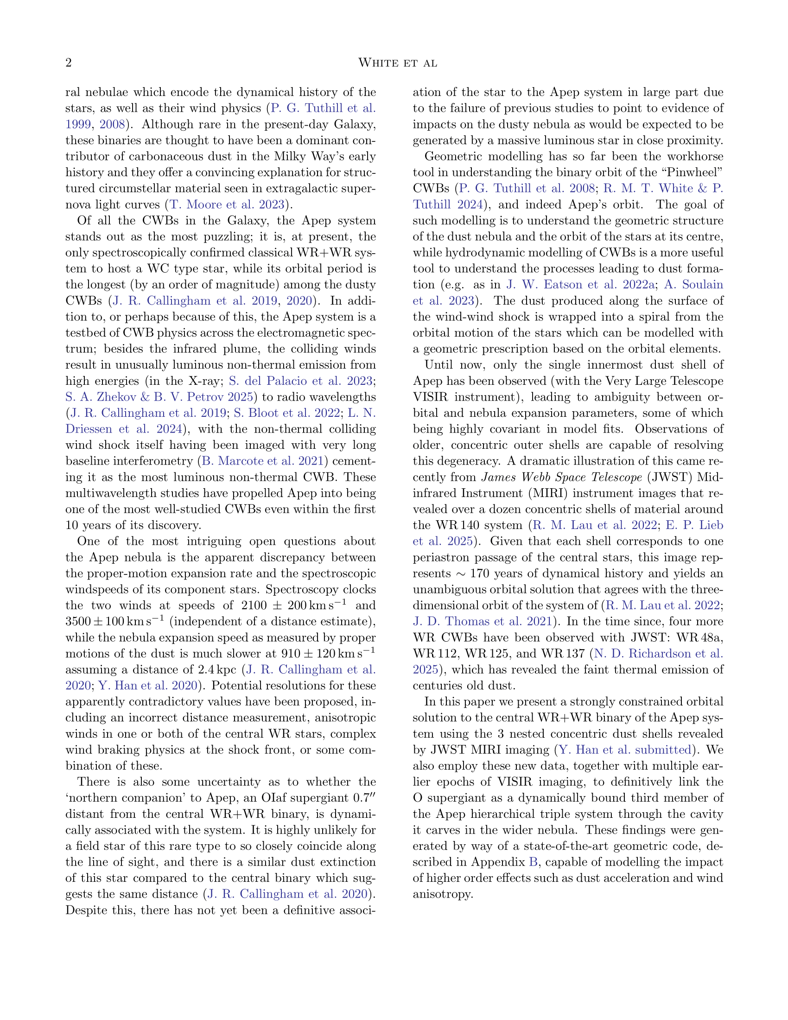











































































































































































































































































Okay, what are these systems and why do we care?
You’re probably familiar with the Sun. It’s a fairly average star. Most stars are a lot lighter than the Sun, and there are also many that are a *lot* heavier - some can be up to 100 times more massive. Those that are initially ~30 times or more as massive as our Sun will eventually get rid of most of their hydrogen, leaving behind a core of helium, carbon, and nitrogen. These cores are called ‘Wolf-Rayet’ stars - after the two French dudes who discovered them - and they are exceptionally bright stars, with unusually strong winds.
The (average) Sun
The much cooler (but actually hotter) Wolf-Rayet star
It might be strange to think of stars having winds, but our Sun does too! This is why we have aurorae on Earth: the solar wind interacting with our atmosphere. A Wolf-Rayet star’s wind is about a trillion times more powerful than that of our Sun. Almost 10 years ago, our team found a system with two of these Wolf-Rayet stars and they named it Apep. More about Apep soon...
Because Wolf-Rayet stars have no hydrogen, their winds are made up entirely of helium and carbon*. This means that they can be very efficient factories of carbon dust - jumbled together grains of carbon molecules. This dust goes on to form new Solar Systems and planets!

Slide 3
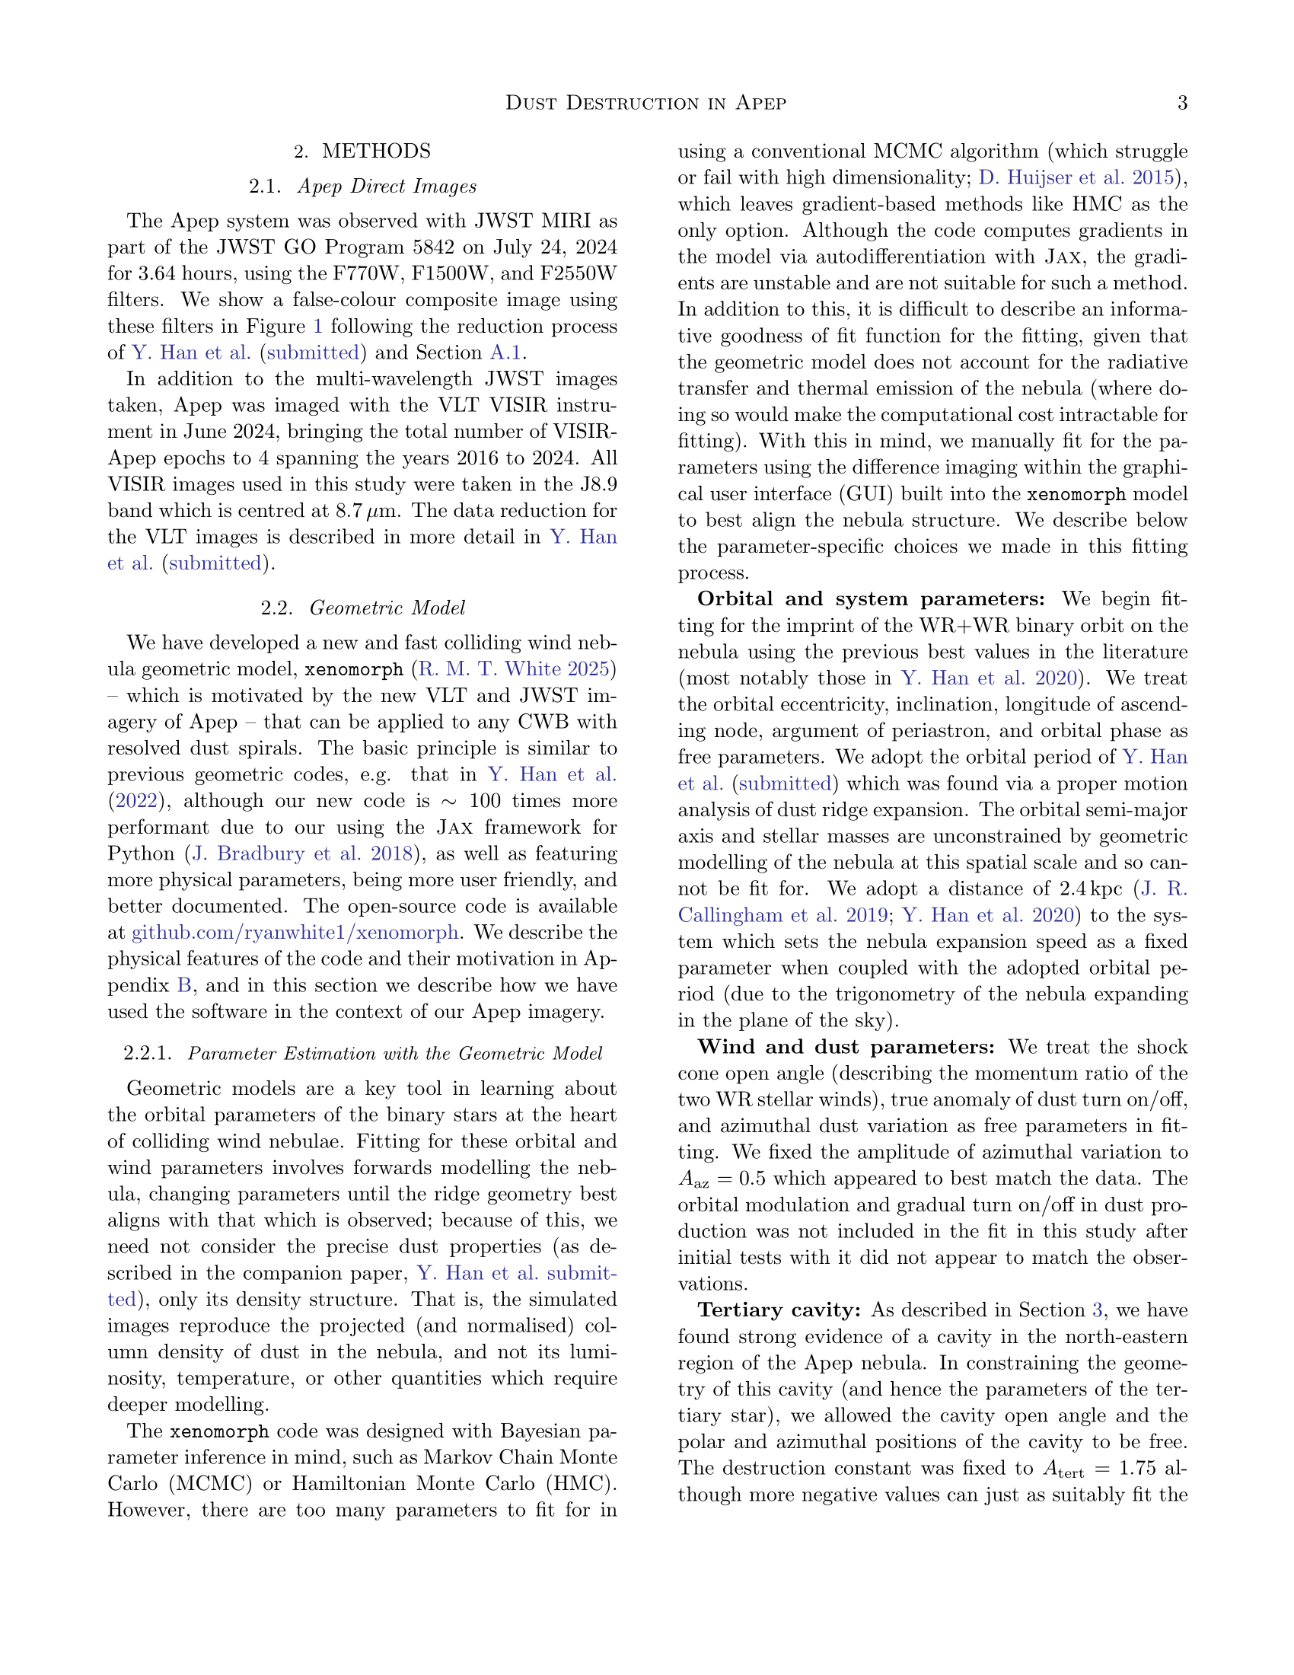

































































Double trouble?
Most of these Wolf-Rayet stars, like our Apep system, are in binary or higher order systems - systems where two or more stars orbit a common centre of mass. Each of these massive stars have their own wind, and so somewhere between the stars their winds collide which ‘shocks’ the wind, compressing it and mixing it together.

Slide 4
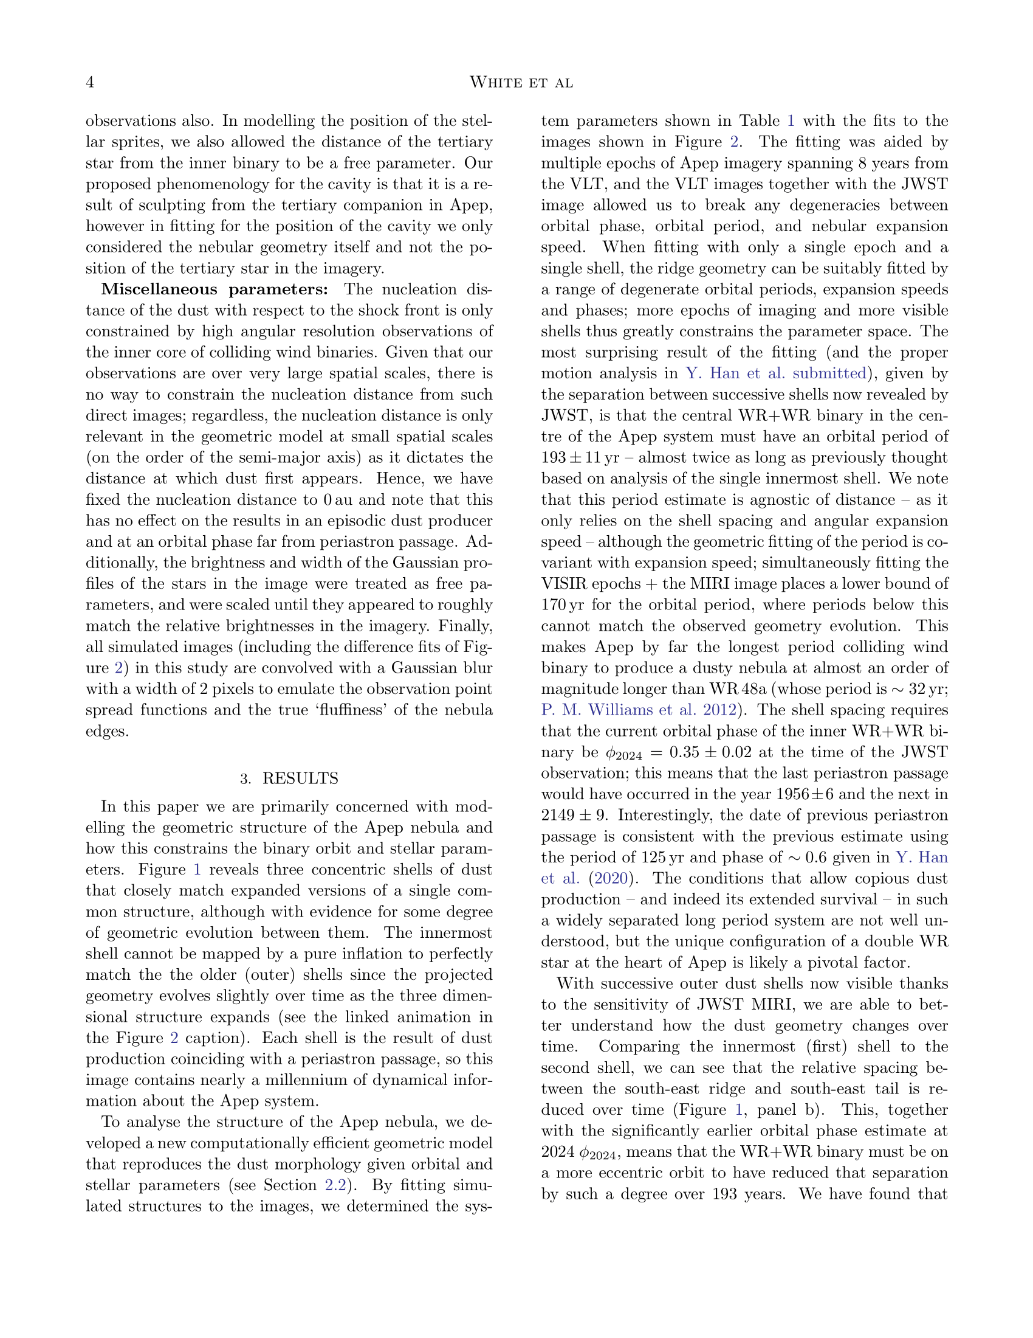

Slide 5
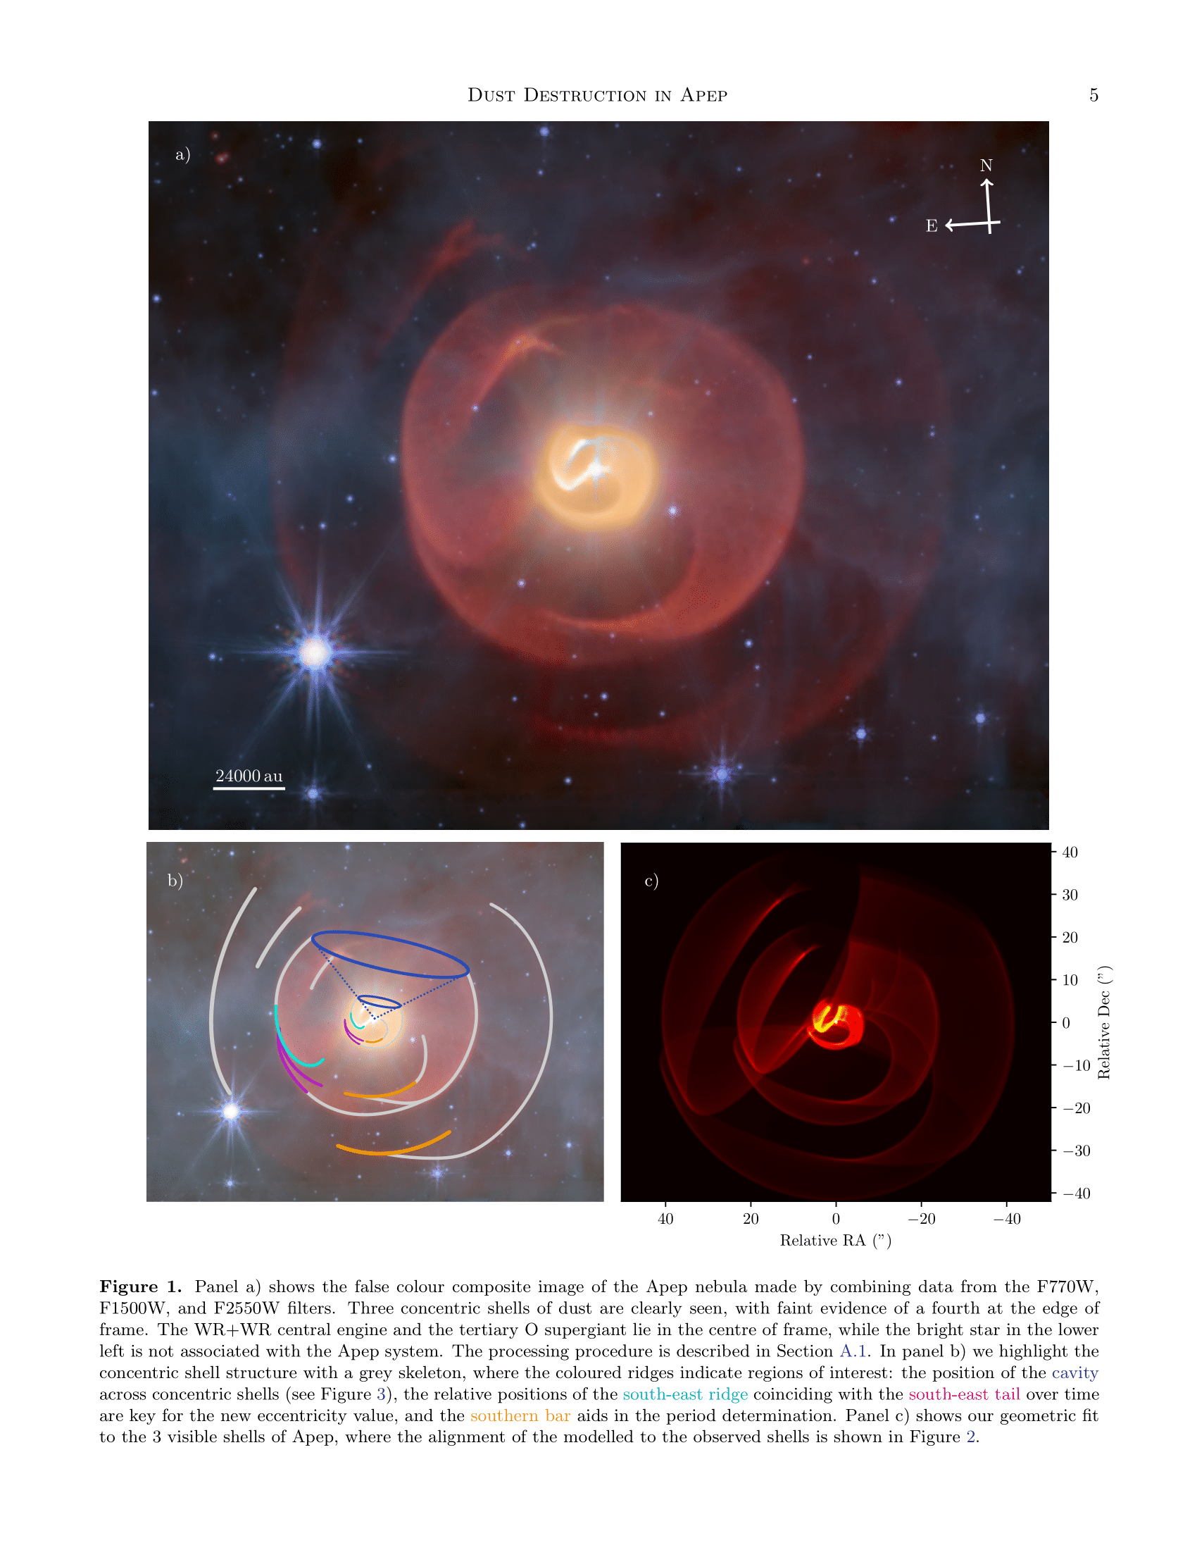

Slide 6
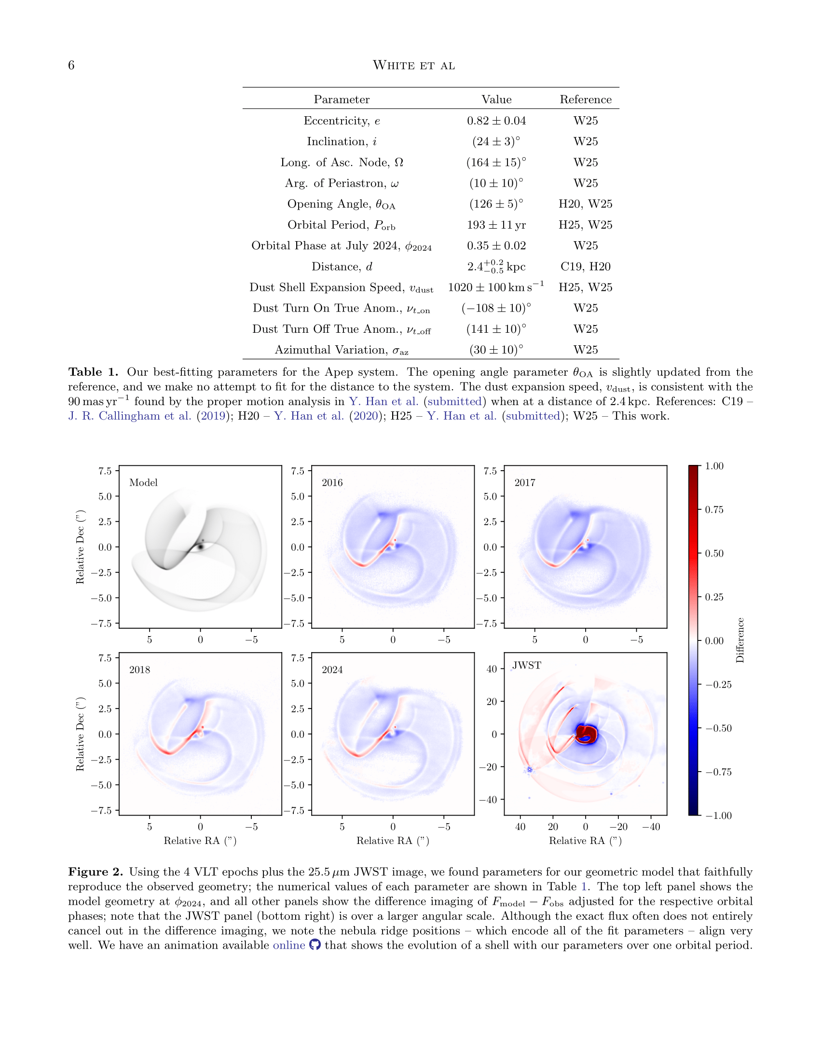

Slide 7
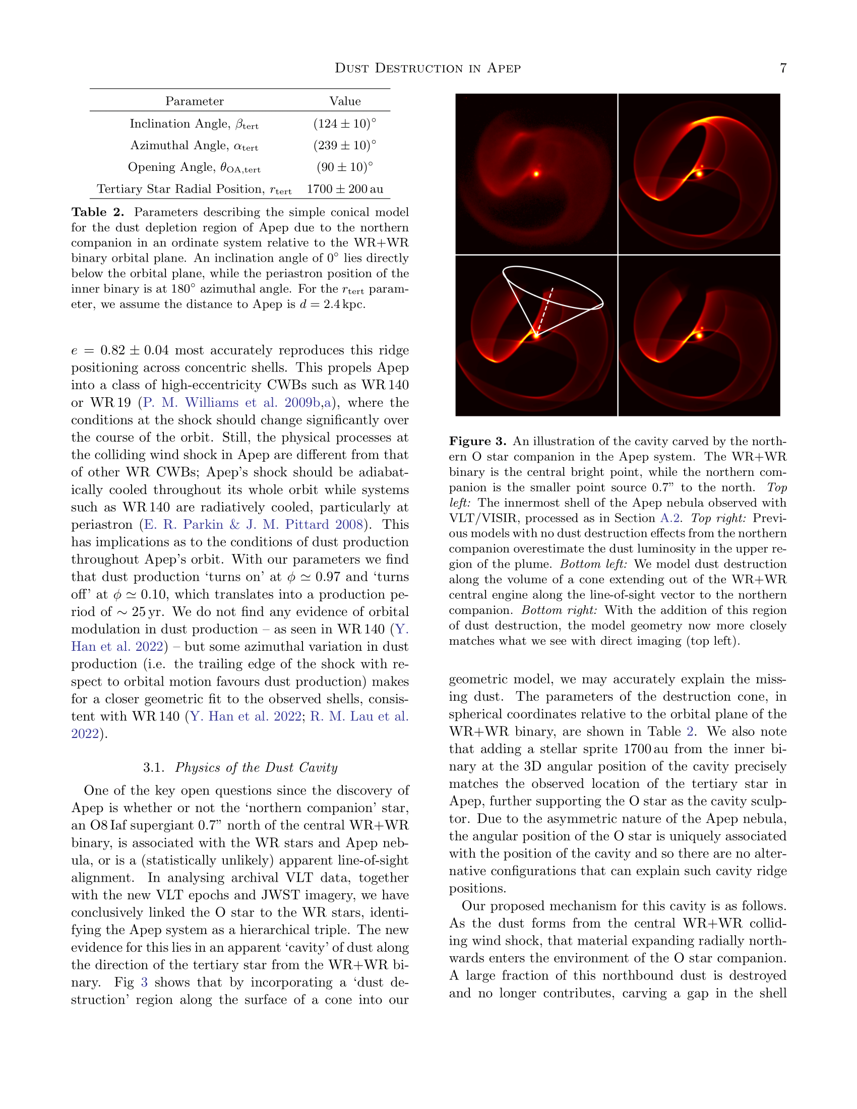

Slide 8
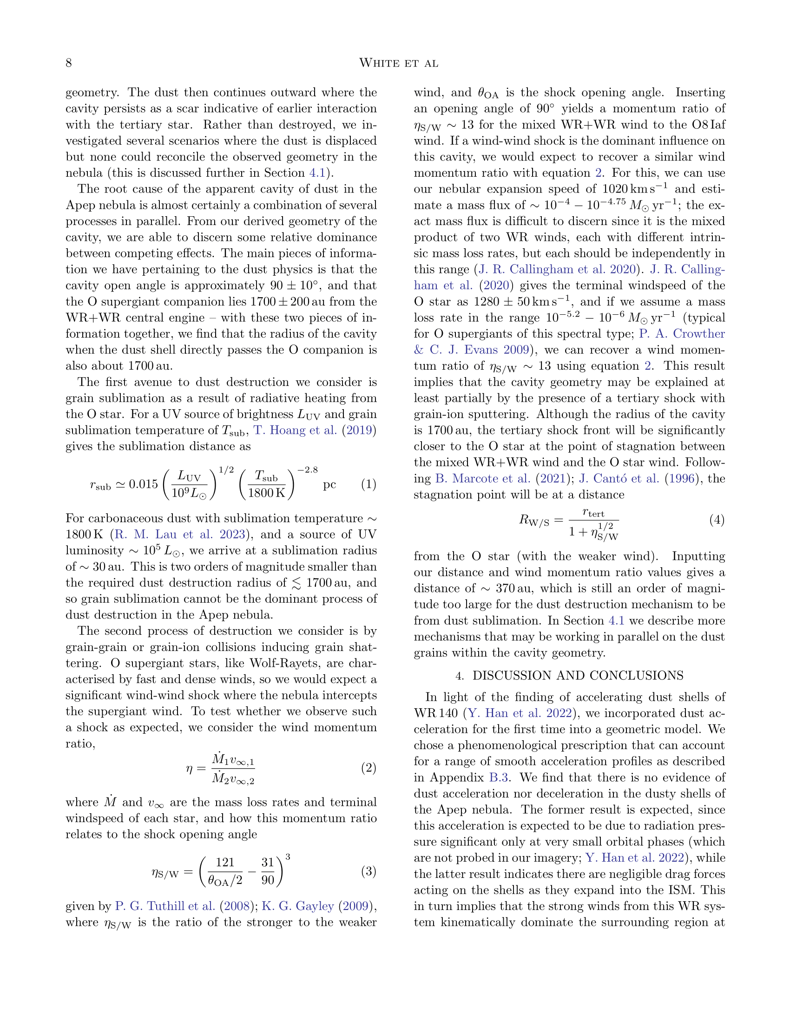

Slide 9
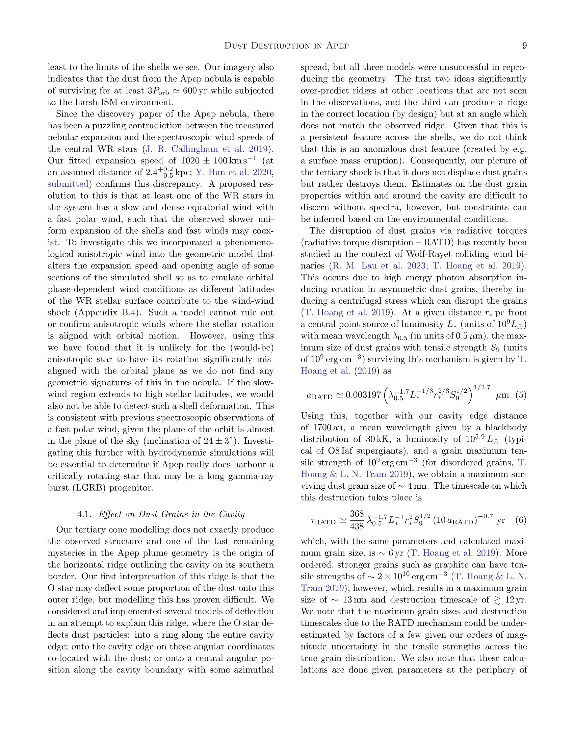

Slide 10
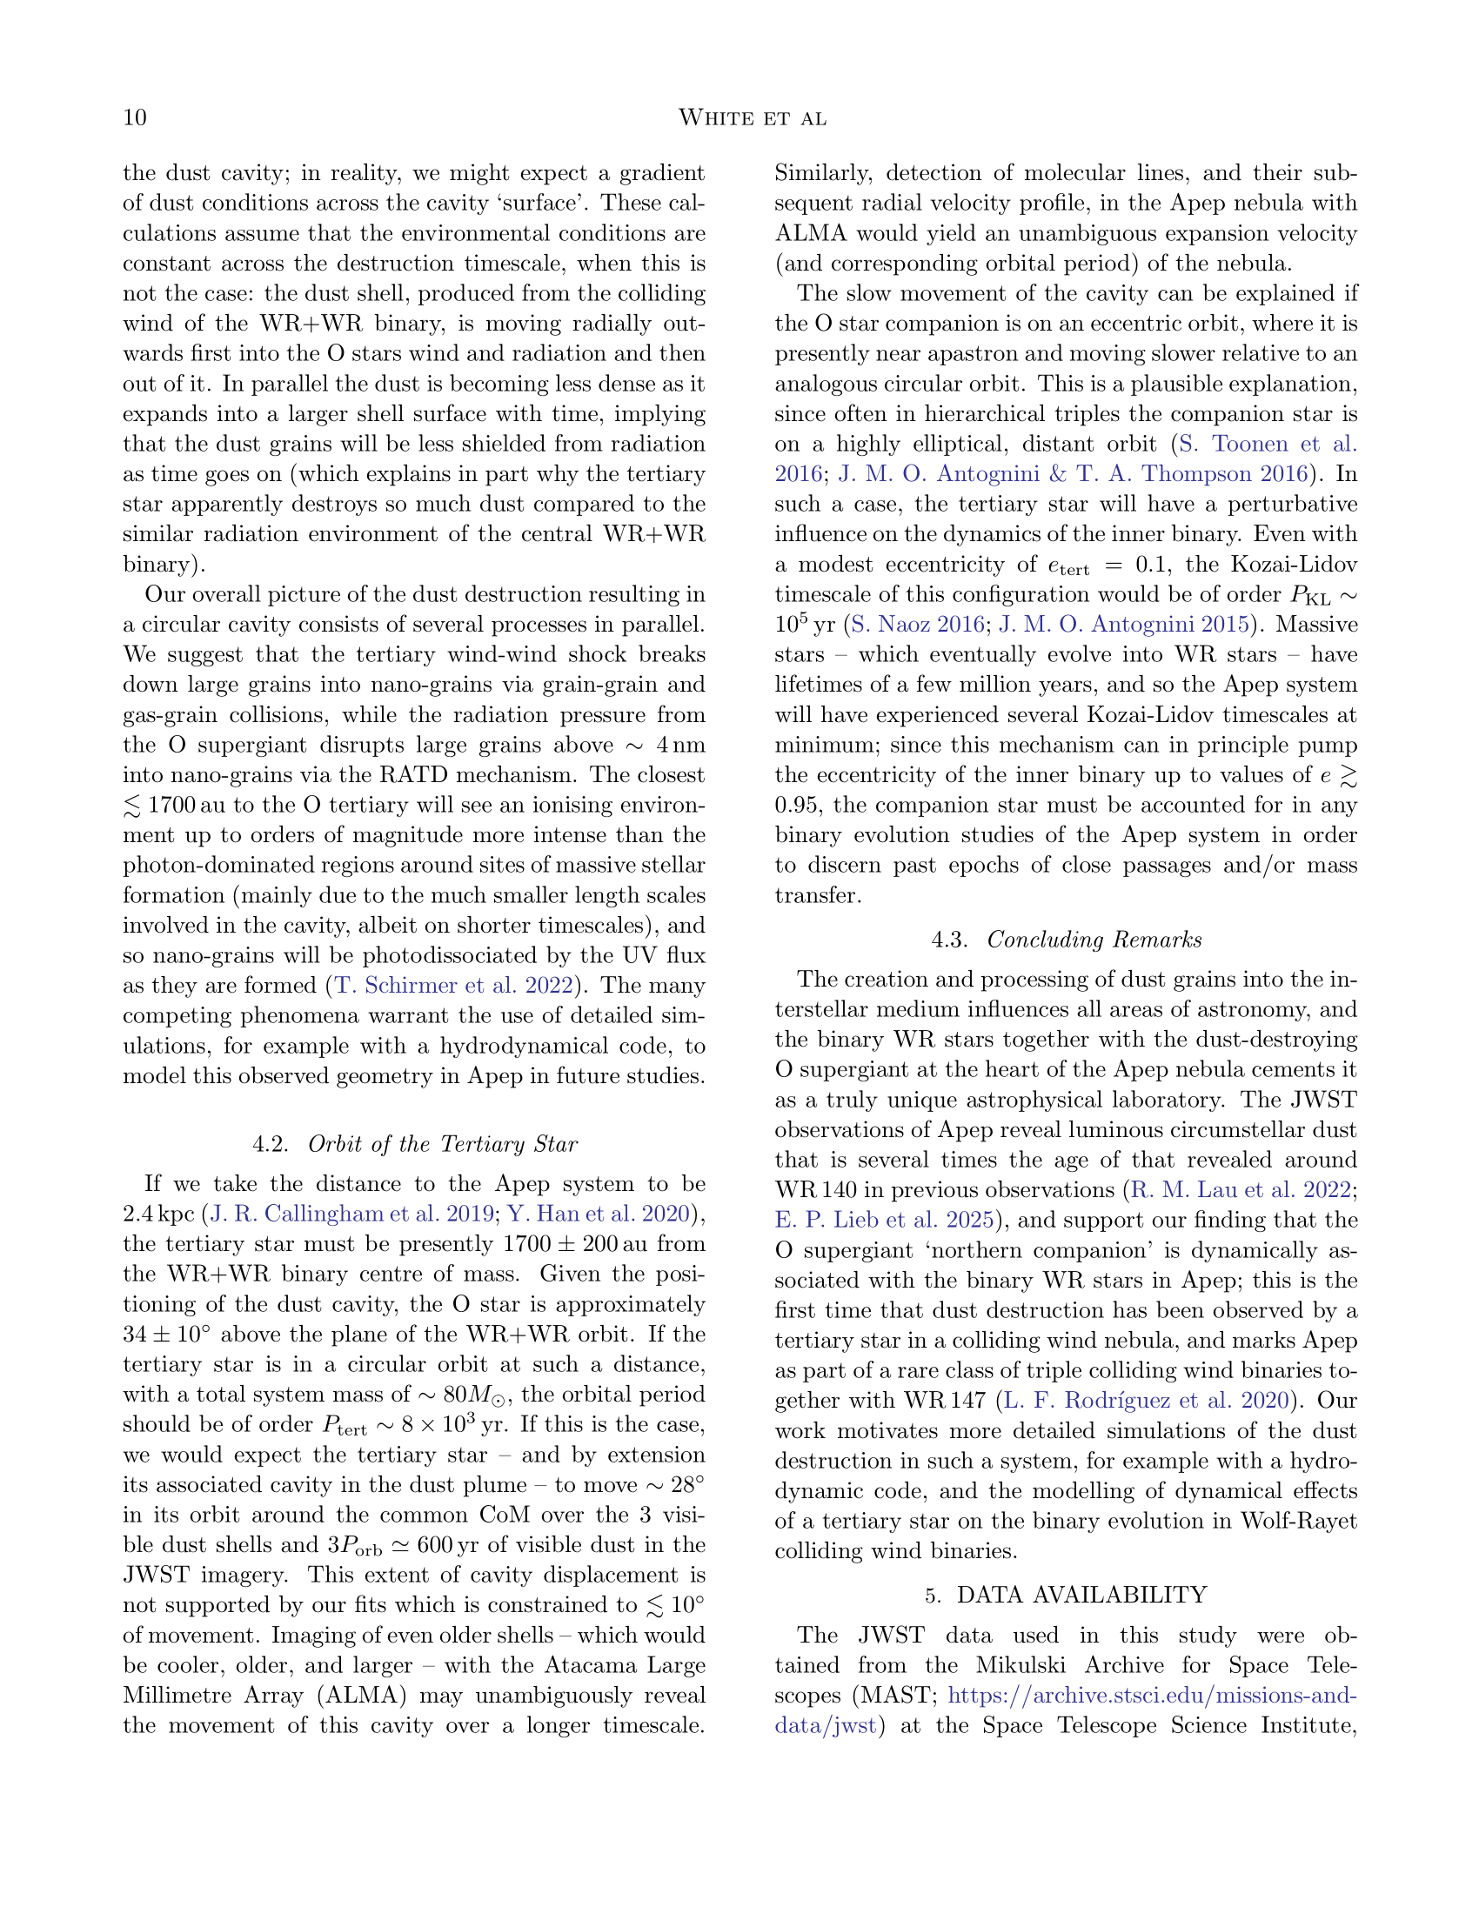

Slide 11
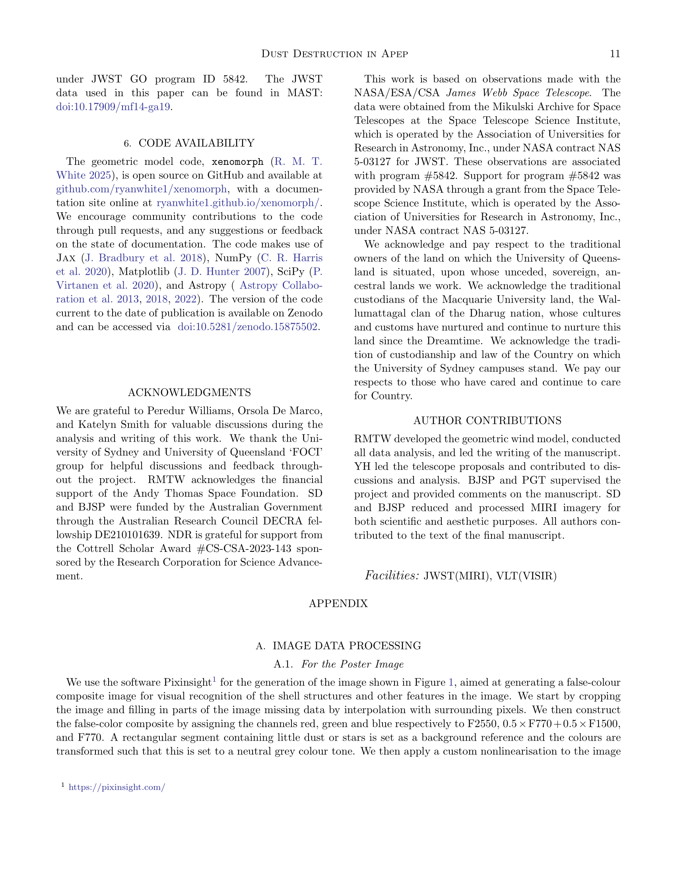

Slide 12
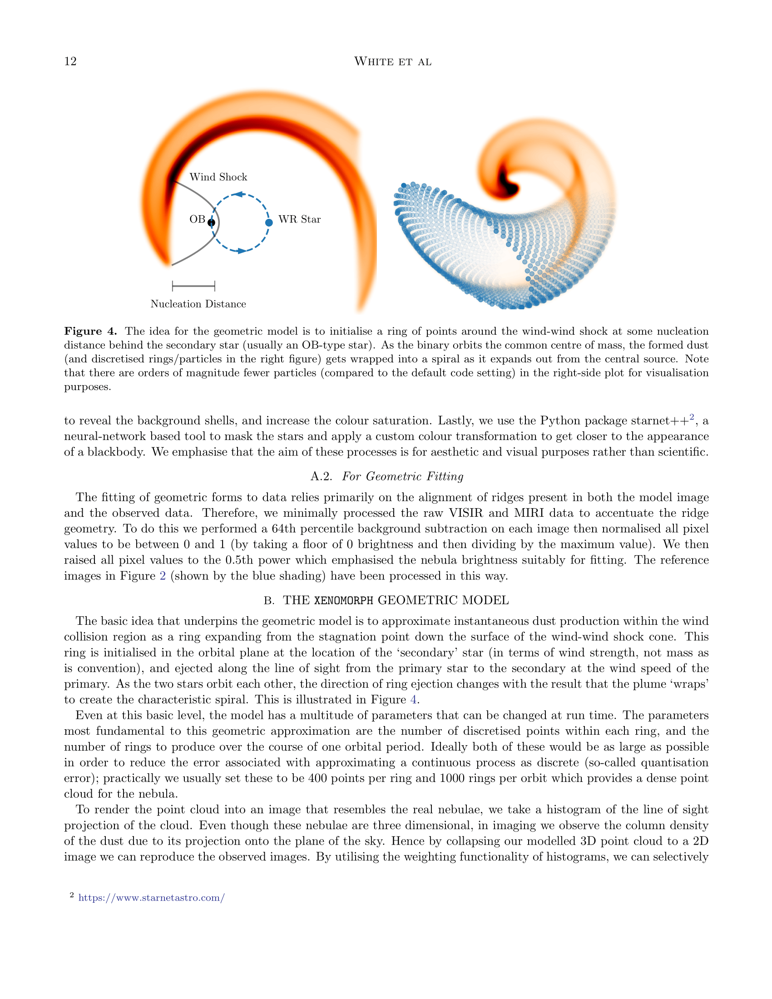

Slide 13
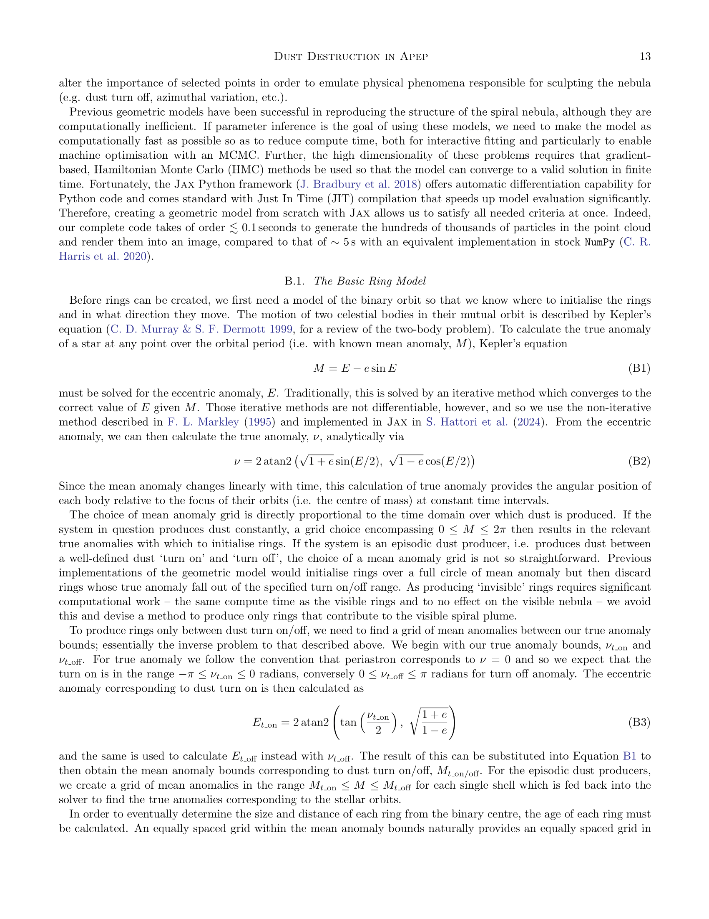

Slide 14
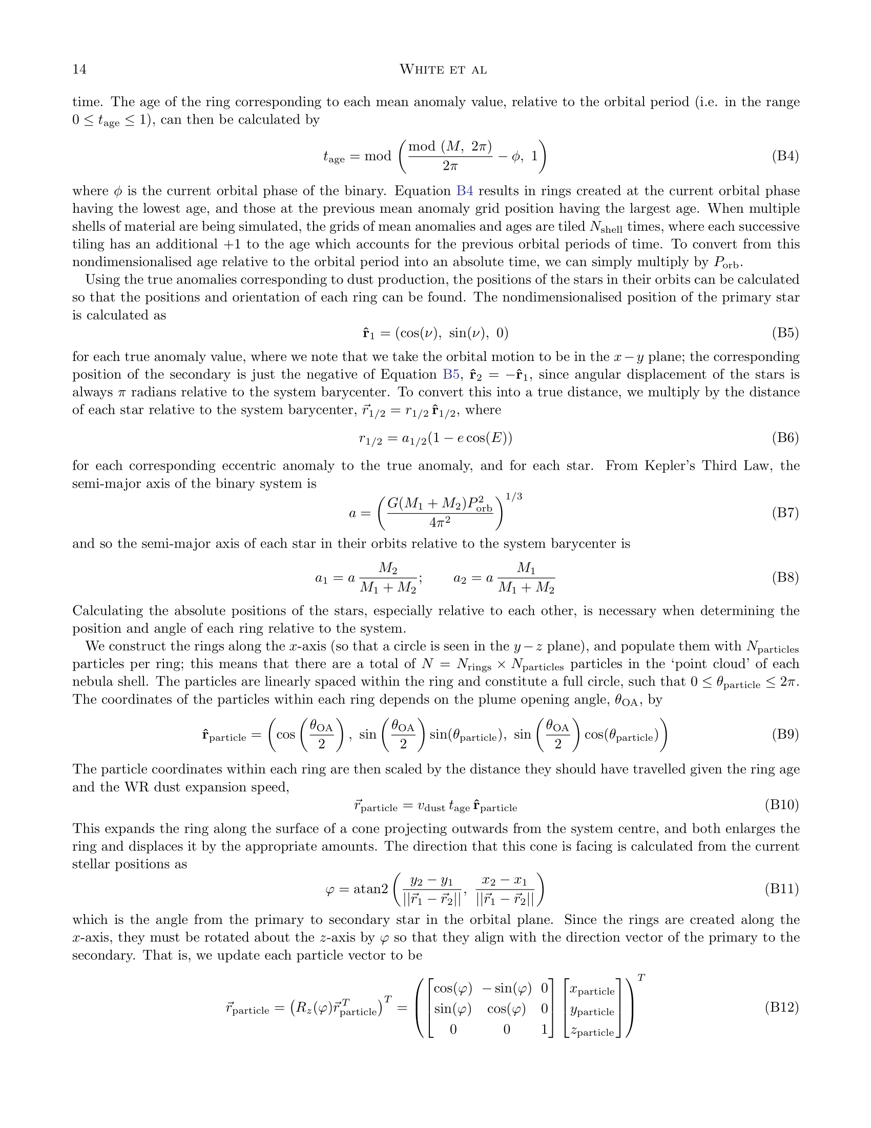

Slide 15
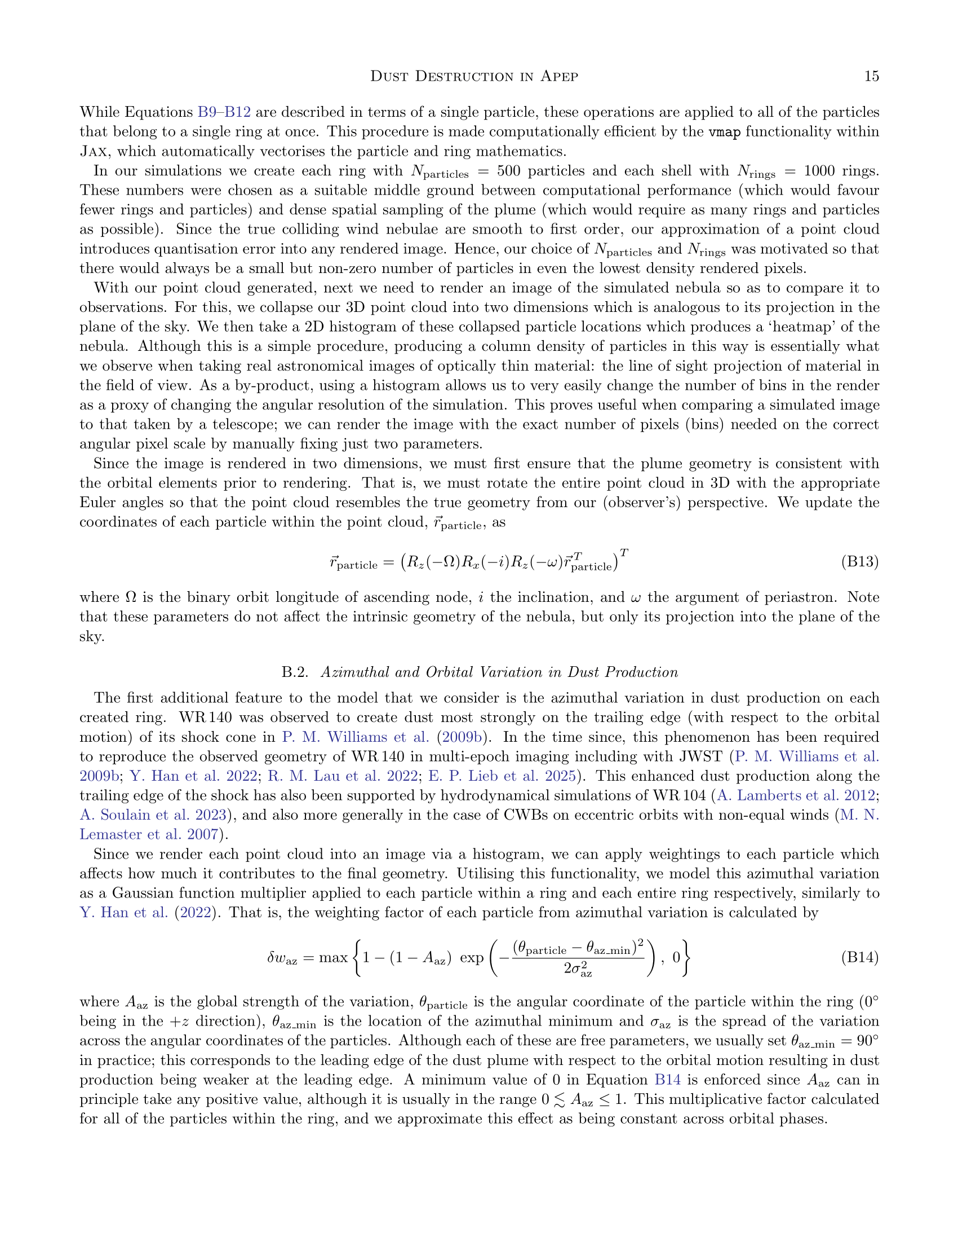

Slide 16
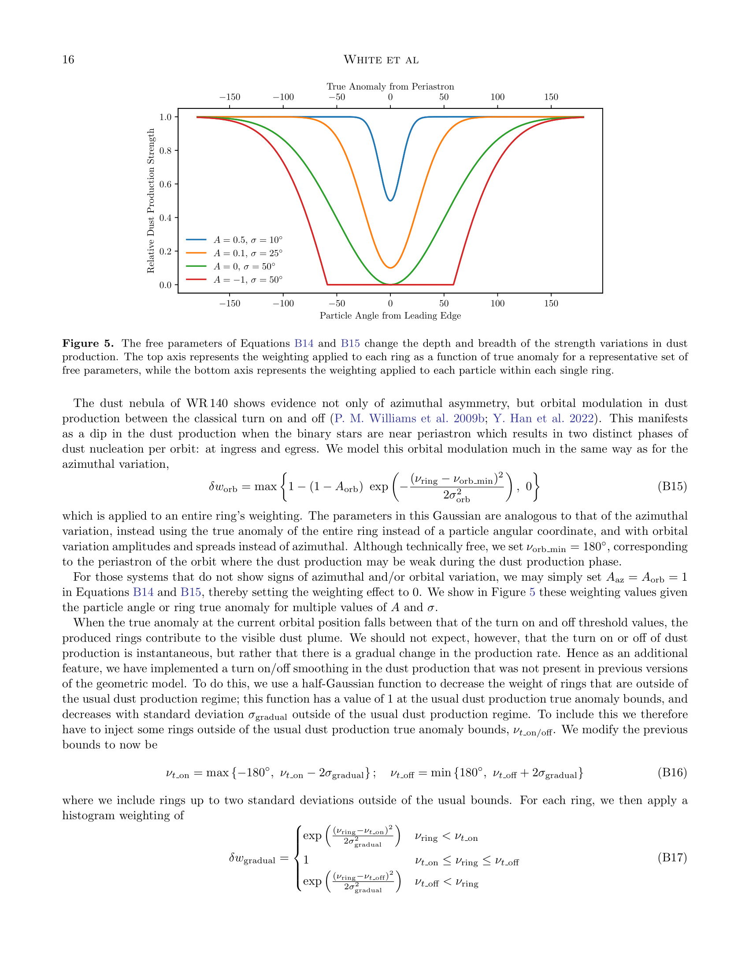

Slide 17
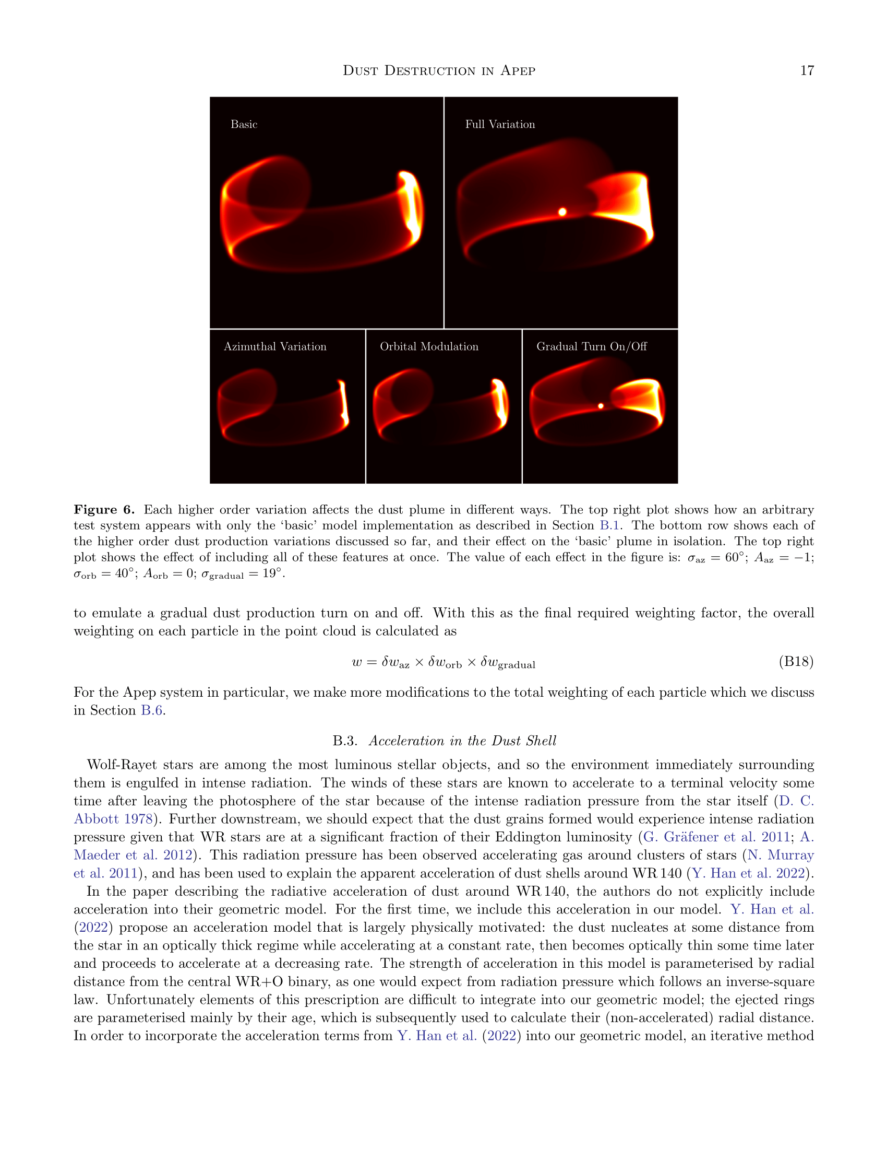

Slide 18
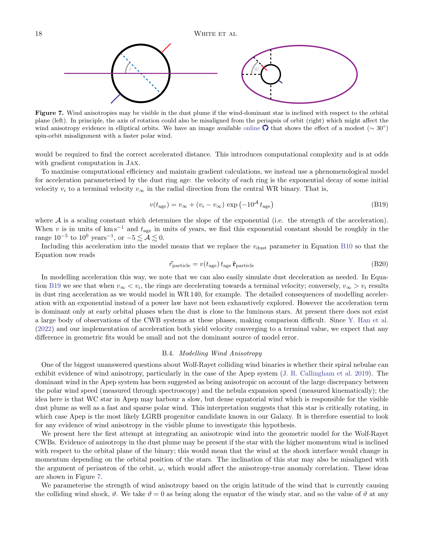

Slide 19
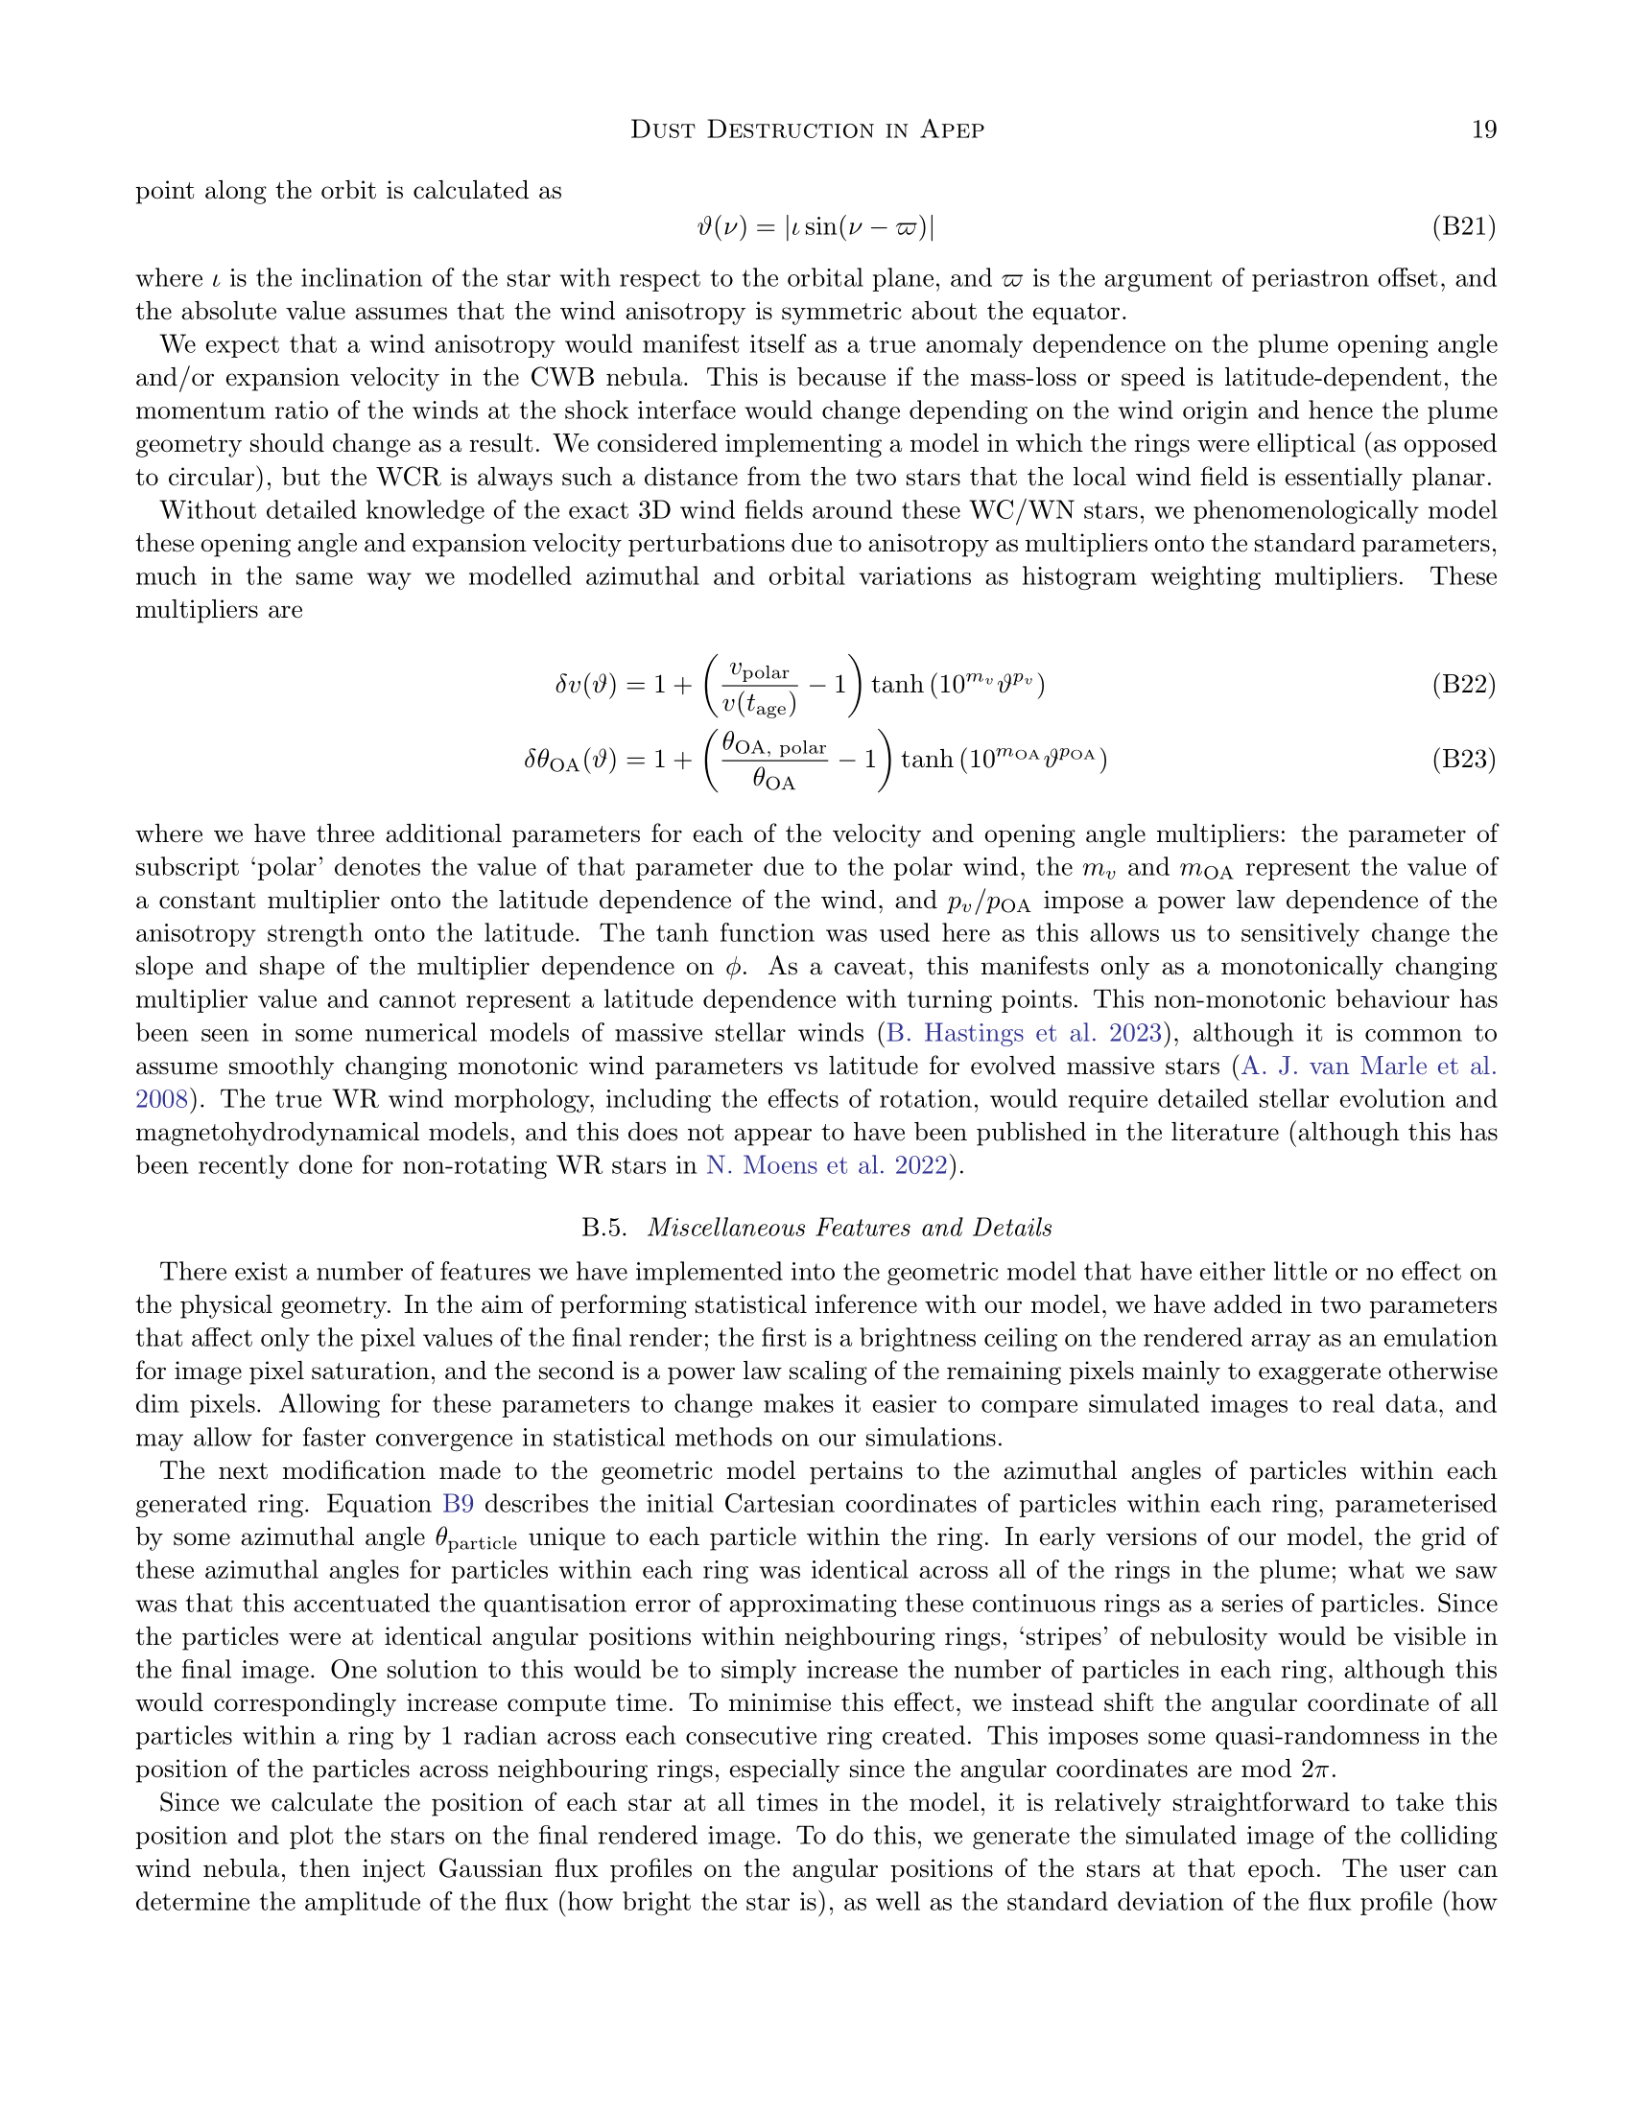

Slide 20
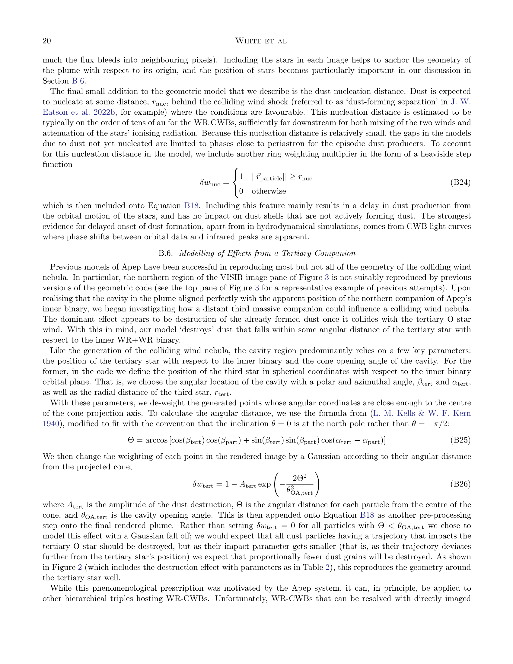

Slide 21
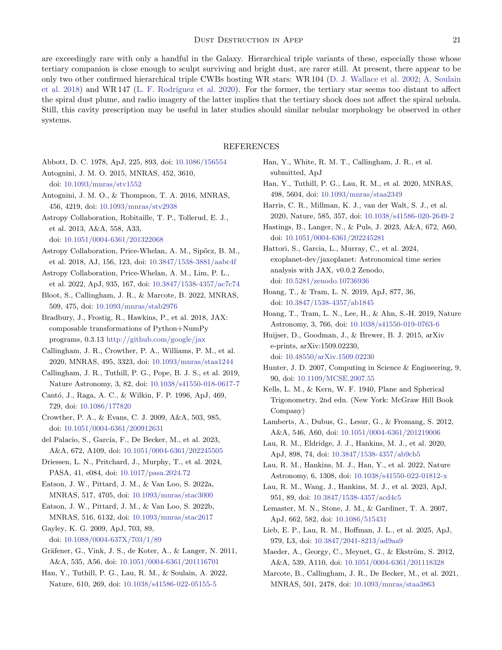

Slide 22
